Slide 1
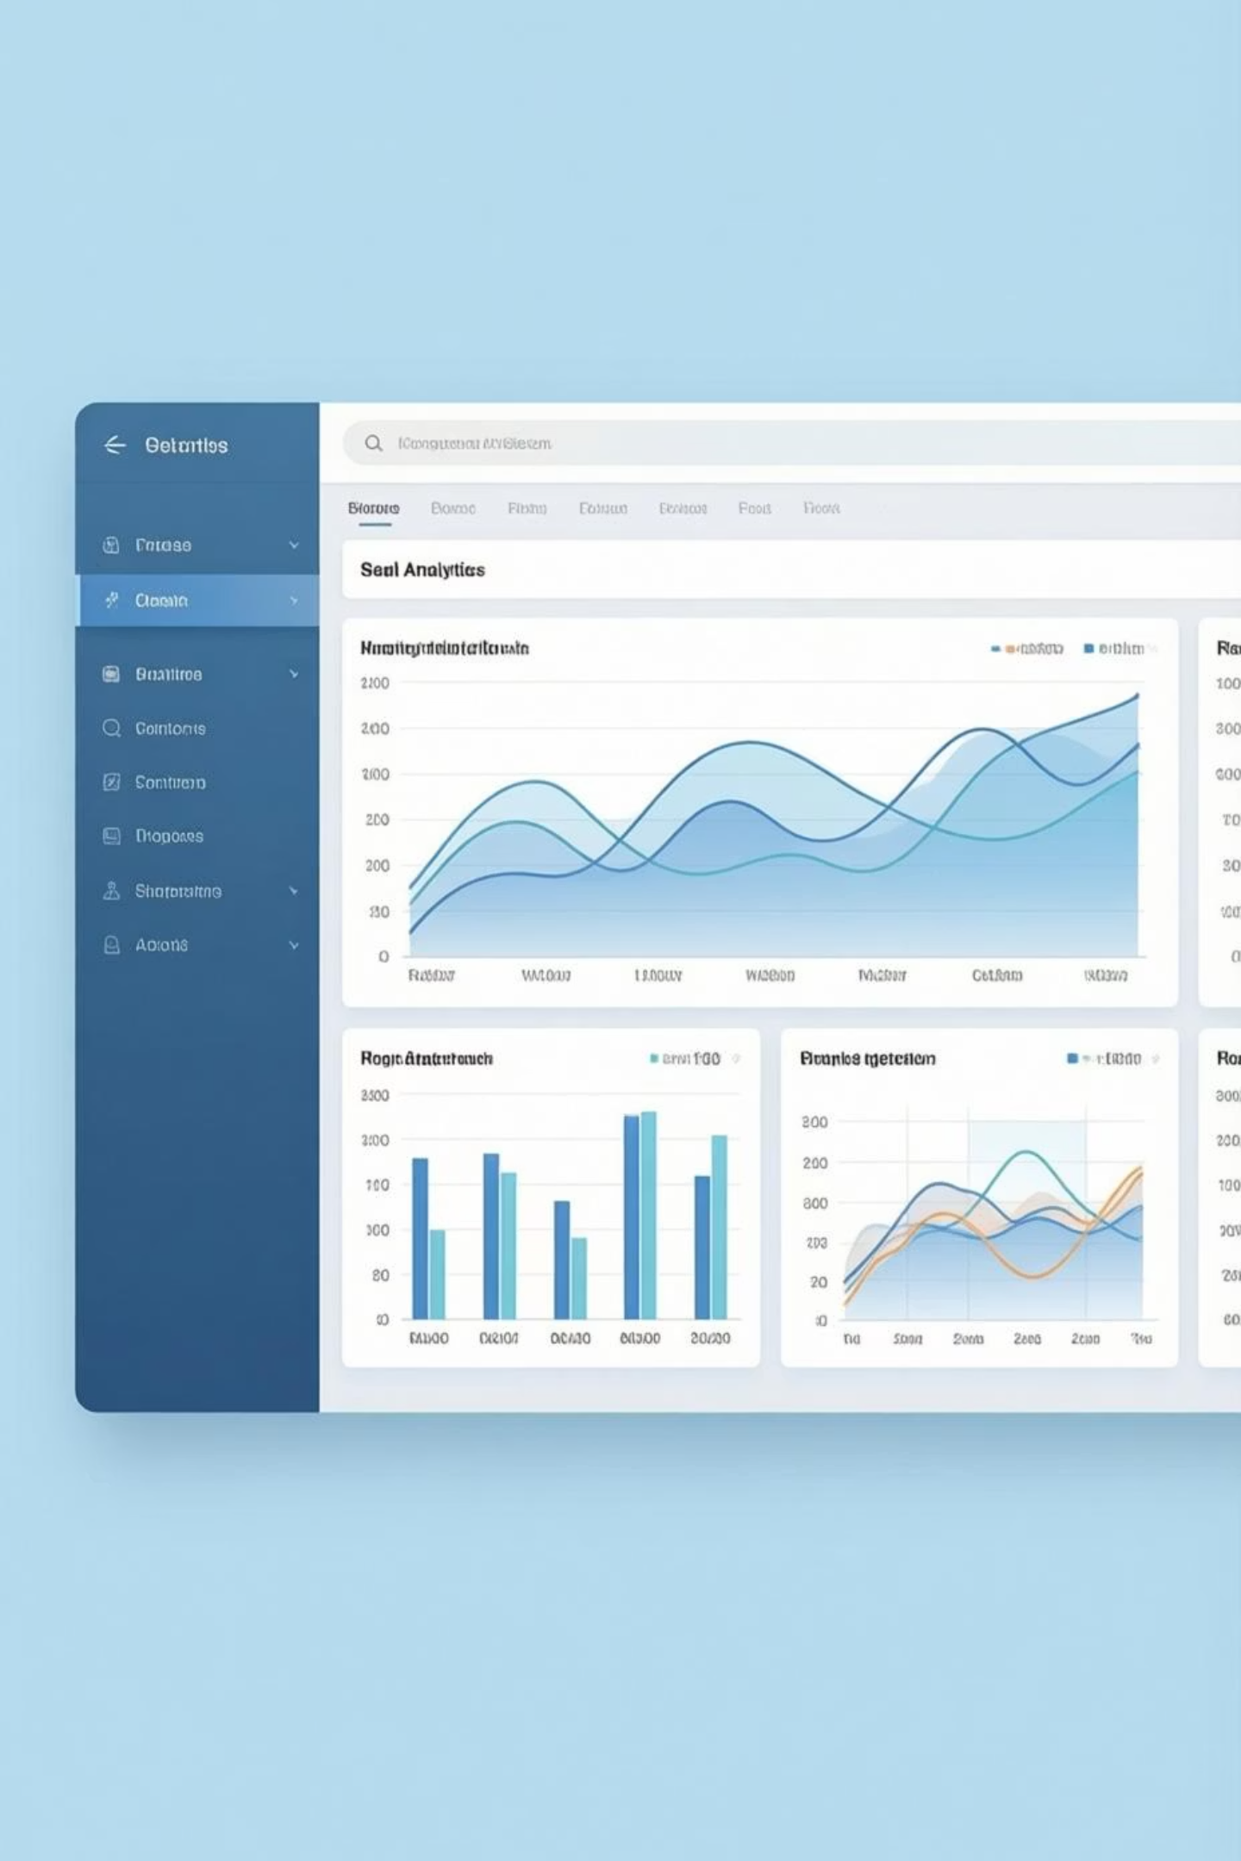
Customer Trends Data Analysis
End-to-End Retail Analytics using SQL, Python, and Power BI
Mangalapuri Gayathri | January 2026

Slide 2

PROJECT OBJECTIVE
Transforming Customer Data into Business Insights
Analyze Behavior
Identify Trends
Drive Action
Uncover customer purchase patterns across demographics, product categories, and payment methods.
Discover key patterns by gender, age, subscription status, discounts, and repeat purchases.
Provide actionable insights for marketing, sales strategies, and customer retention programs.

Slide 3

Tools & Technologies
1
SQL
Data extraction, segmentation, and advanced querying for deep analysis.
2
Python
Data cleaning and preprocessing using Pandas and NumPy libraries.
3
Power BI
Interactive dashboards and compelling business visualizations.
An integrated analytics workflow combining data processing, querying, and visualization to deliver comprehensive insights.

Slide 4

Dataset Overview
01
Demographics
Customer ID, age groups, gender distribution
02
Transactions
Purchase amounts, item categories, payment methods
03
Behavior
Subscription status, discounts, review ratings, purchase frequency
04
Preprocessing
Data cleaned and standardized for accurate analysis

Slide 5


KEY INSIGHTS
Gender & Age Demographics
2x
$62K+
Male Revenue
Young Adults Lead
Male customers contribute more than double the total purchase value compared to females.
Young Adults generate the highest revenue across all age groups.
Opportunity: Launch targeted campaigns by gender and age segments to maximize sales potential and customer engagement.

Slide 6
Product Performance & Customer Ratings
Top Rated: Gloves
Most Ordered: Jewelry
High Demand: Blouse
Popular: Sandals
Highest rating at 3.86 stars
High ratings and orders
Leading category by volume
Consistent top performer
Strategic Insight: Promote top-rated and high-demand products in marketing campaigns and optimize inventory planning to meet customer preferences.

Slide 7

Subscription & Customer Loyalty
Subscription Status
Customer Segments
Repeat Buyers
Non-subscribers drive majority revenue while subscribers show similar per-order spending patterns.
Loyal customers form the majority
High repeat purchase rates among non-subscribers present a conversion opportunity.
Returning customers show growth potential
New customers represent opportunity
Convert frequent buyers into subscribers through targeted loyalty programs and exclusive offers.

Slide 8



Discounts & Shipping Preferences
48%
50%
Discount Usage
Price Sensitivity
Nearly half of top products purchased with discounts applied
Customers respond strongly to promotional pricing strategies
Shipping Insights
Express shipping orders show higher average purchase values compared to standard delivery options.
Strategic Recommendation: Optimize discount targeting and promote premium shipping to increase average order value and customer satisfaction.

Slide 9




ACTION PLAN
Business Recommendations
Target Segments
Promote Winners
Focus on high-value customers: Male and Young Adult demographics with personalized campaigns.
Feature top-rated and high-demand products in marketing and inventory strategies.
Build Loyalty
Optimize Revenue
Convert frequent non-subscribers through loyalty programs and exclusive subscriber benefits.
Refine discount and shipping strategies to maximize average order value.

Slide 10
Project Outcomes & Impact
Demonstrated Capabilities
Business Value Delivered
Actionable insights for marketing teams
End-to-end analytics workflow mastery
Data-driven sales strategies
SQL querying and data extraction
Customer retention recommendations
Python data preprocessing expertise
Portfolio-ready analytics project
Power BI interactive visualization
Transforming raw customer data into strategic business intelligence through modern analytics tools and methodologies.

